Slide 1
Finding herbivorous marsupials in Australia
Capria Nordquist, May 2020

Slide 2
Introduction/Business Problem
The majority of tourism in Australia is dependent on the Australian culture and the wildlife that can be found on the continent.
Animals like herbivorous marsupials (including koalas and kangaroos) are extremely popular with tourists from and out of the country
Many tourists don’t know where to go to find these animals in the wild and unknowingly spend money and time at organizations which do not prioritize the health of the animals.
By finding places where tourists can view these animals in the wild and safely from a distance, tourists will be satisfied in their experience and the animals will be preserved from harm.
https://www.touropia.com/gfx/b/2019/07/australia.png

Slide 3
Data Information
The initial data on the different species of herbivorous marsupials was collected from the Atlas of Living Australia, and confirmed with Google Maps data, as well as Foursquare data.
The data showed that most of these animal species were considered protected in Queensland more than any other region
This means that the majority of these animals live in Queensland; the dataframe representing this data can be found in the next slide
https://www.touropia.com/gfx/b/2019/07/australia.png

Slide 4
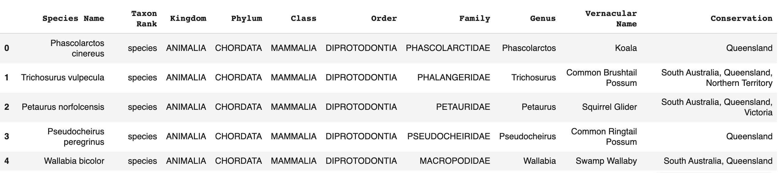
Dataframe on Conservation
From this dataframe (created from the Atlas of Living Australia data), to determine where in Queensland these animals may be most prevalent, I turned to Google Maps.

Slide 5
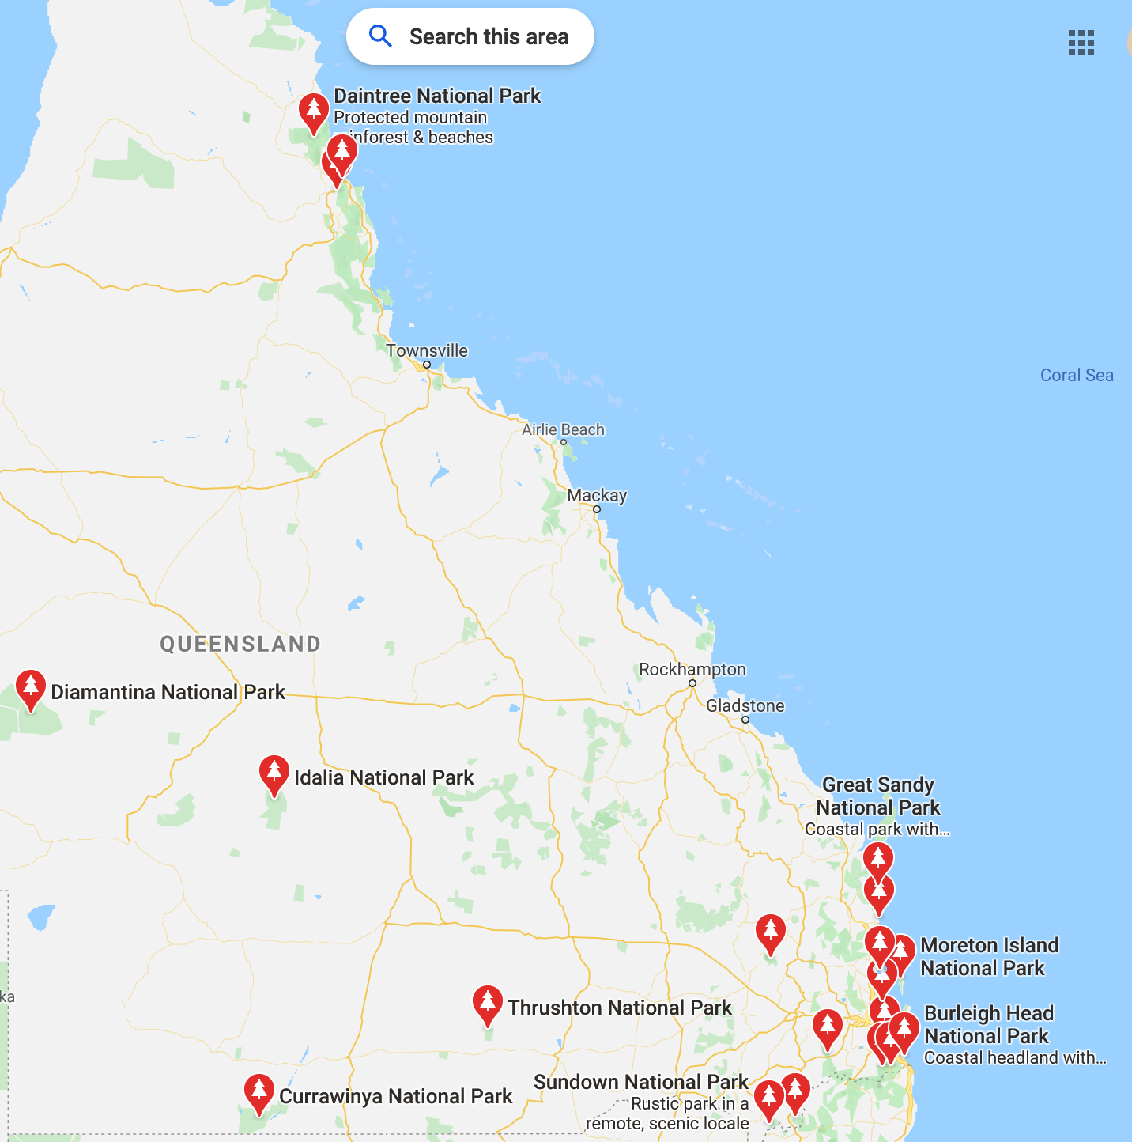
Google Maps-Location Data
Using Google Maps, I pulled up Queensland and all of the national parks that can be found in the region
The majority of the national parks are in the region of Queensland knowns as the ‘Gold Coast’
Australia is a nation littered with national parks and national parks are home to most of the wild animals Australia boasts of

Slide 6
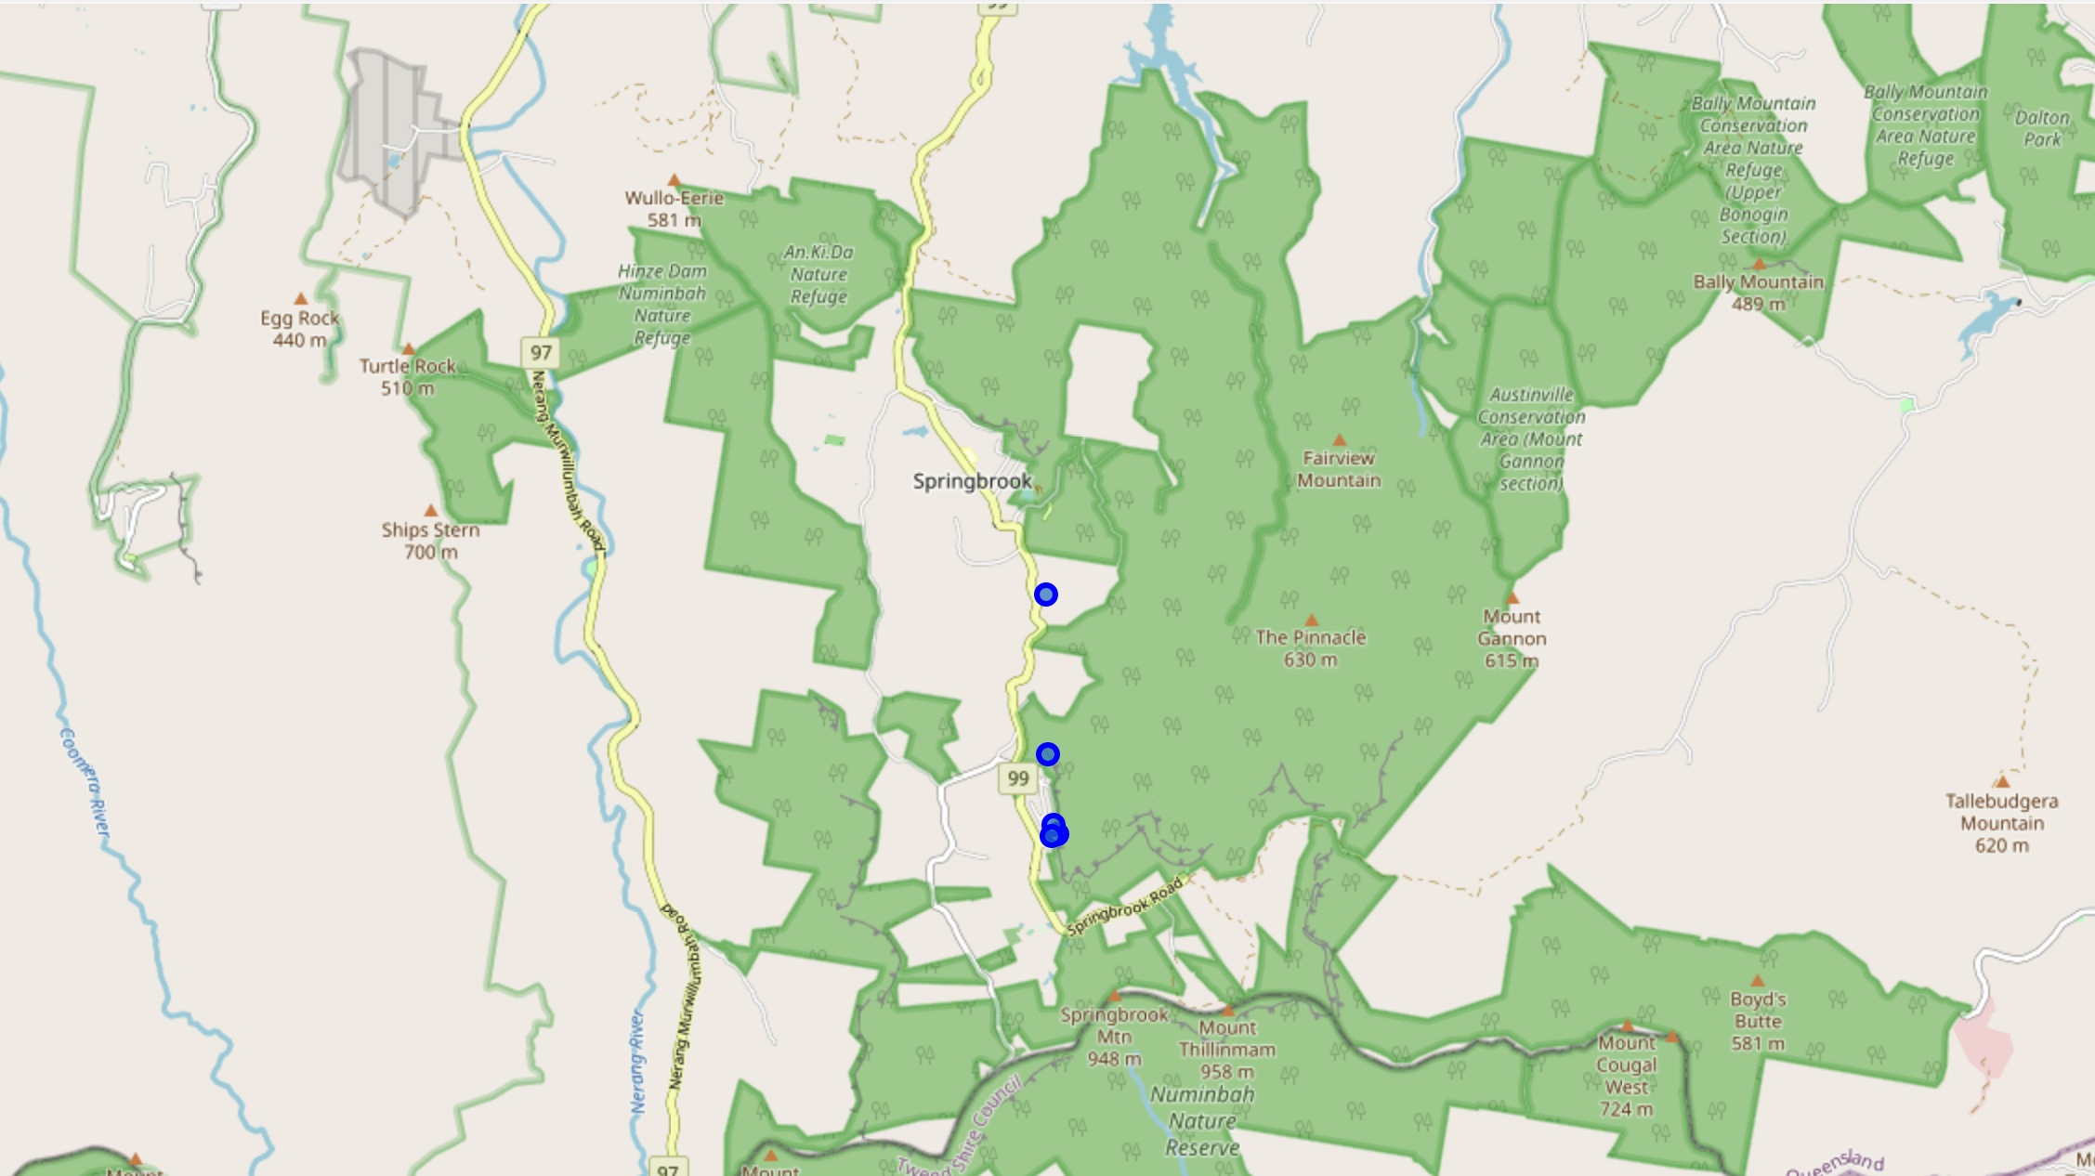
Conclusion
By analyzing the region of Queensland as well as Foursquare data on the Gold Coast region, it was proven that this area has the greatest percentage of wild herbivorous marsupials which tourists can view in their natural habitat
Through data analysis from Atlas of Living Australia, Google Maps, and Foursquare, more tourists have the ability to find these rare and amazing creatures than ever before
With wildfires and humans invading wild spaces, it is crucial now more than ever to safely witness these creatures in the wild
{The background image is geodata from Foursquare which displays the sheer volume of national parks in the Springbrook National Park region which can be found in my Jupyter Notebook}

Slide 7
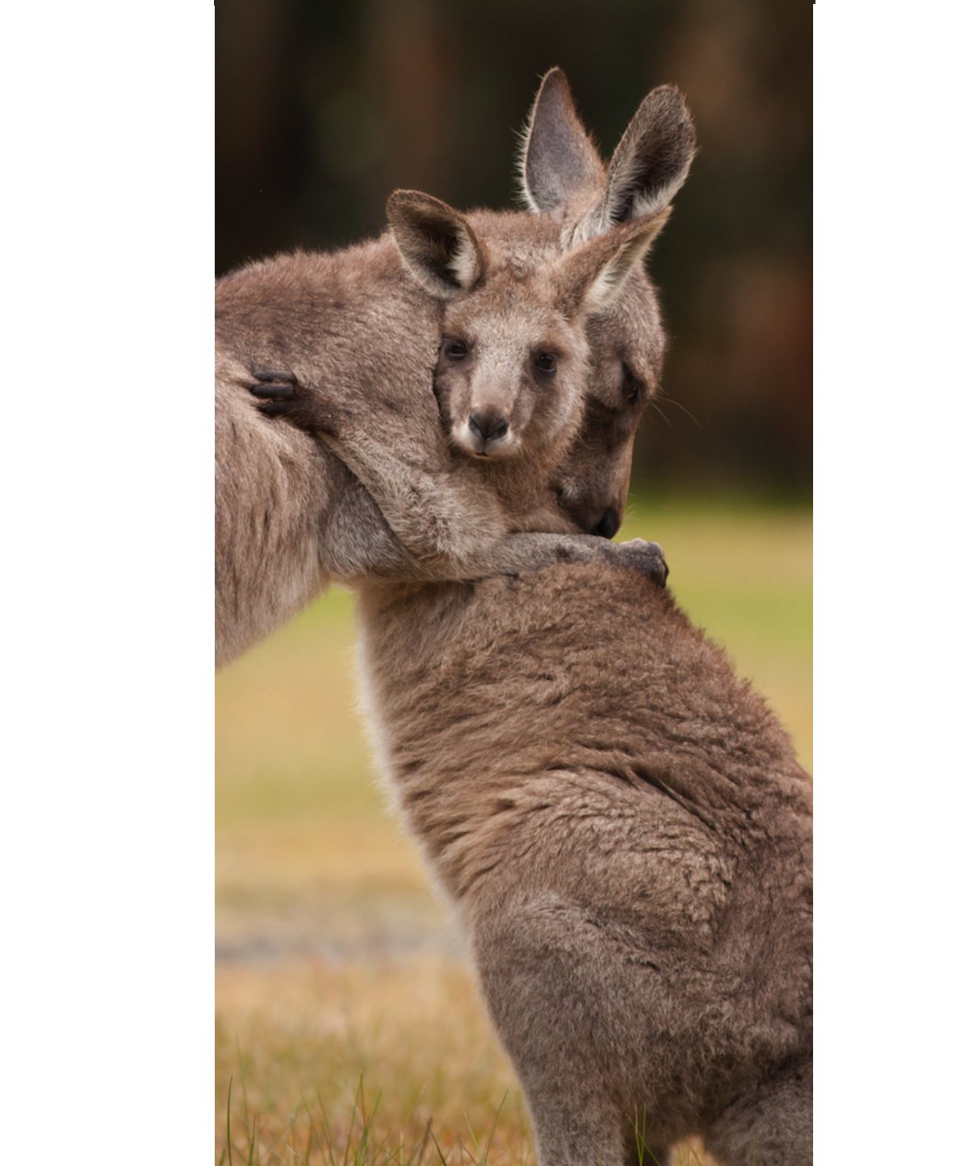
Future Direction
https://cff2.earth.com/uploads/2017/10/16181728/The-extinction-of-fanged-kangaroos-could-save-other-species.jpg
Future analysis of this topic lies in which direction the tourism of seeing herbivorous marsupials is most prevalent. Is it in seeing them in the wild in national parks, snuggling up with potentially sedated animals at improper animal organizations, or viewing the workings of proper animal rehabilitation and stabilization sanctuaries?
Further, future analysis of this problem using Foursquare requires more extension research into the capabilities of Foursquare. The possibility of being able to search for national parks specifically in a region instead of just ‘venues’ could greatly increase the accuracy of the data.
Lastly, more research on the various population densities of these animals would greatly increase determining where the greatest chance of finding these marsupials are.

